Slide 1


Visual Perception and Eyetracking:
Eye Movement and its Analysis
Jacek Matulewski
Institute of Physics, NCU
ICNT, UMK
WWW: http://www.fizyka.umk.pl/~jacek
E-mail: jacek@phys.uni.torun.pl
TAPS, 22-08-2018

Slide 2
Senses
Humans receptors
Vision 250 000 000 photoreceptor cells
Olfaction (smell) 40 000 000 chemoreceptors
Haptics, pain 2 500 000 mechanoreceptors
Taste 1 000 000 chemoreceptors
Hearing 25 000 mechanoreceptors
Receptors are in whole body
80% inform. about envir. – vision, 10% cerebral cortex
Source: http://www.if.pwr.wroc.pl/~wozniak/kolorymetria_pliki/

Slide 3
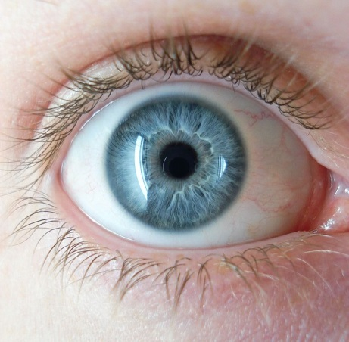
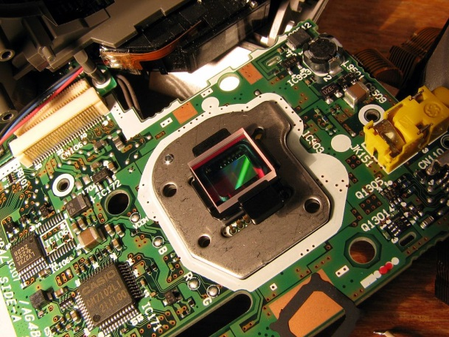
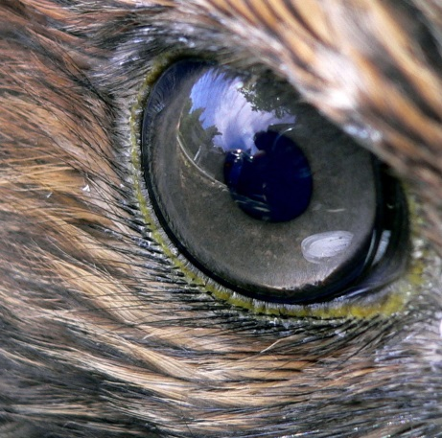
Visual perception
Human eye
200,000 photocells / mm² (average)
90 millions of rod cells (light intensity, night)
4,5 millions of cone cells (color, day vision)
Bird of prey (eagle, falcon)
1 milion of photocells / mm²
CCD (lub CMOS)
10 Mpx / cm² = 0.1 Mpx / mm²
Image source: Wikipedia

Slide 4
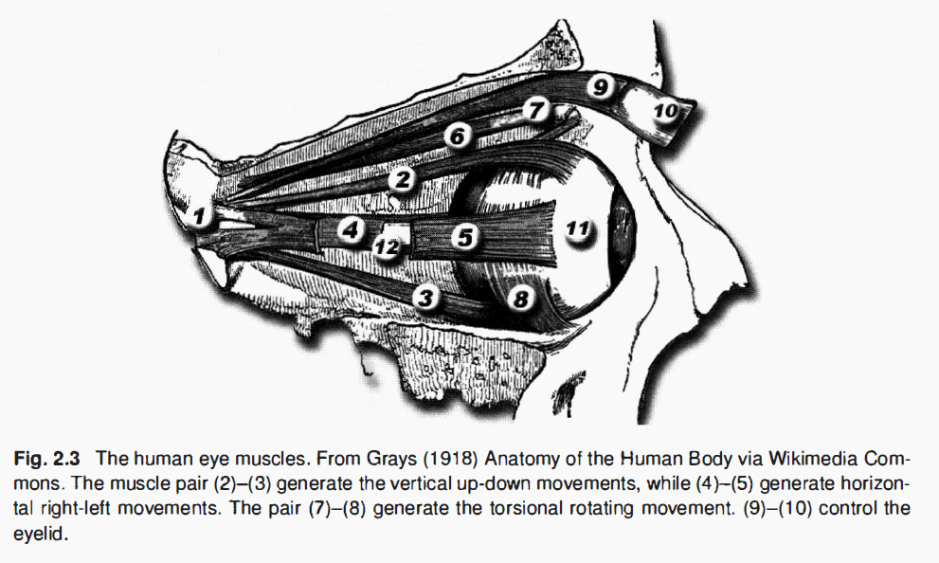
Visual perception
How many degrees of freedom does the human eye have?
Source: Holmqvist i in. Eye Tracking. A Comprehensive Guide to Methods and Measures

Slide 5
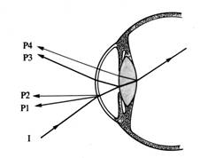
Purkinje images
Sclera
Cornea
P4 - reflection from the inside
the surface of the lens
P3 - reflection from the outside
the surface of the lens
P2 - reflection from the inside
corneal surface
P1 - reflection from the outside
corneal surface (glint)
Lens
incoming ray
Iris
Image source: https://ppw.kuleuven.be/home/english/research/lep/images/resources/eye1

Slide 6
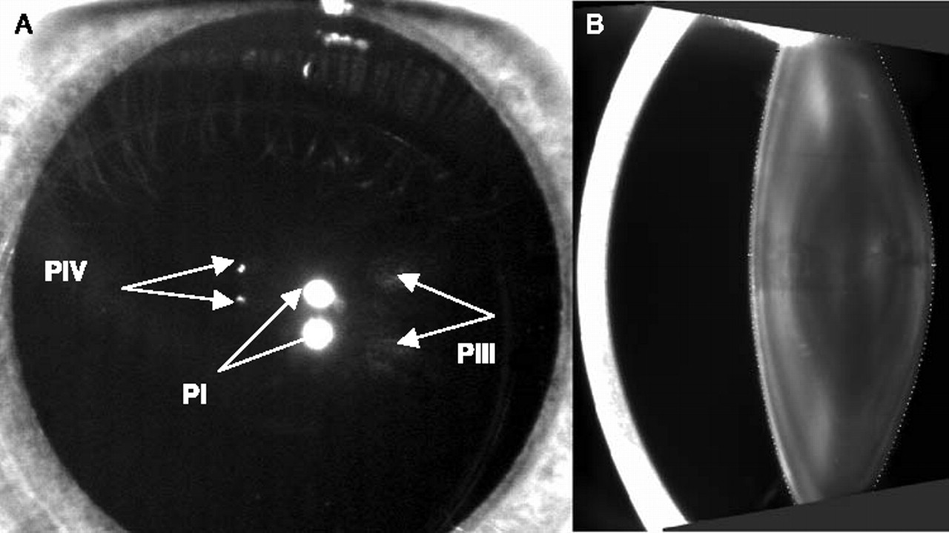
Purkinje images
Image source: http://www.eyetracking.com/Hardware/Eye-Trackers

Slide 7
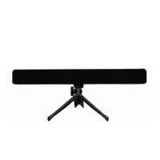
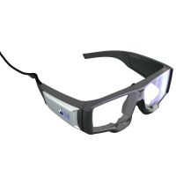
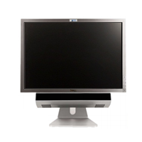
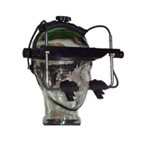
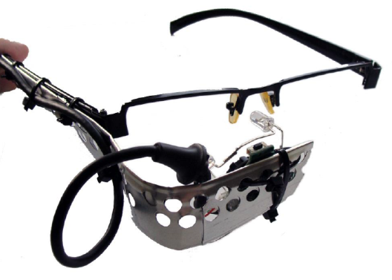
Eyetracker – hardware
Mirametrix
SMI
SMI
Remote and
head-mounted
eye trackers
EyeLink
Kamil Pleskot
Image source: http://www.eyetracking.com/Hardware/Eye-Trackers

Slide 8
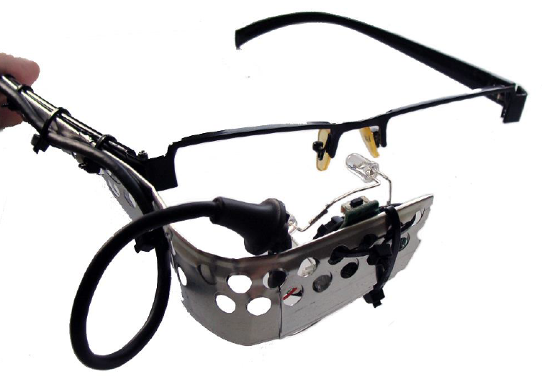
Eyetracker – DIY hardware
ophthalmic
frame (old)
IR diodes
CMOS sensor
(from web cam)
USB cable
Source: Kamil Pleskot (engineering thesis)

Slide 9
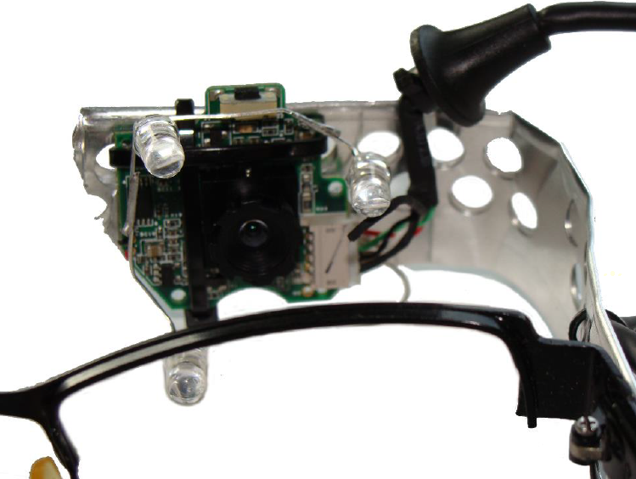
Eyetracker – DIY hardware
IR diodes
CMOS sensor
(from web cam)
frame of
glasses
Source: Kamil Pleskot (engineering thesis)

Slide 10
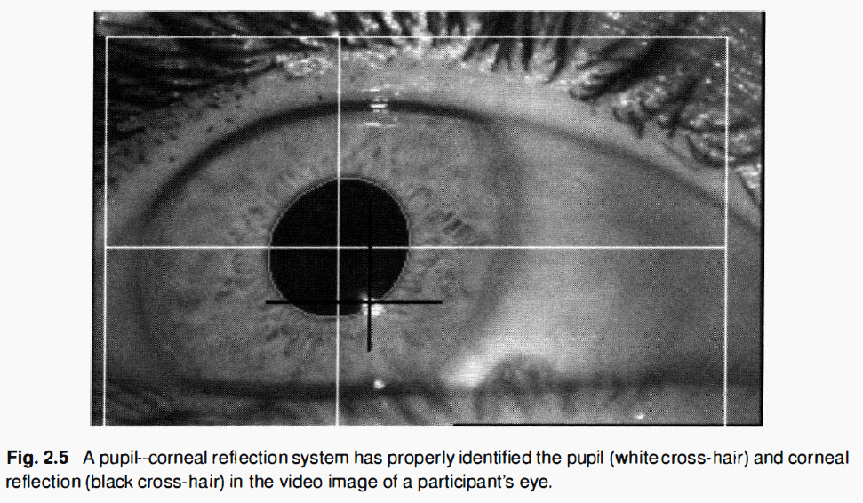
Eyetracker – software
The use of P1 (glint) makes the gaze position detection
independent on the movement of the head
Source: Holmqvist i in. Eye Tracking. A Comprehensive Guide to Methods and Measures

Slide 11
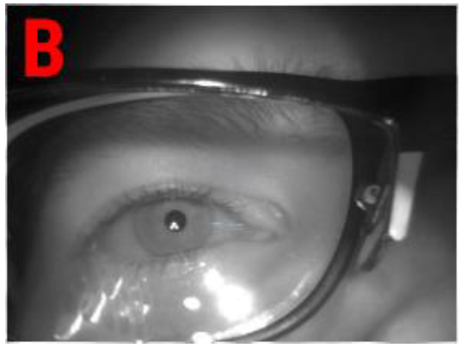
Eyetracker – software
Glasses make the glint recognition harder
Source: Kamil Pleskot

Slide 12
Eye movement
Eyes never stop moving.
La saccadé (fr. jolt, jerk, rapid movement)
During wake time – 200,000 saccades.
During sleep, the eye movement changes (REM - rapid eye movements).
The small part of the eye movements is controlled consciously (like breathing)
Most of the movements (including the microsaccades) are not controlled
and we are not aware of them. Otherwise the image would be constantly shaking.
Even during fixation on the subject the eye is not still!
Microsaccades - movements of the eye with a smaller amplitude "within" the fixation object. The microsaccades are responsible for "refreshing" the image (stimulating the eye rods and cons).
Without it we would see only moving objects (like some animals).
Erasmus Darwin (Charles’ grandfather, 1794): staring at a very small piece of
silk on paper - the color gradually fades and disappears!
Susanna Martinez-Conde http://static.trogu.com/documents/articles/palgrave/references/martinez-conde%20vision%20saccades.pdf

Slide 13
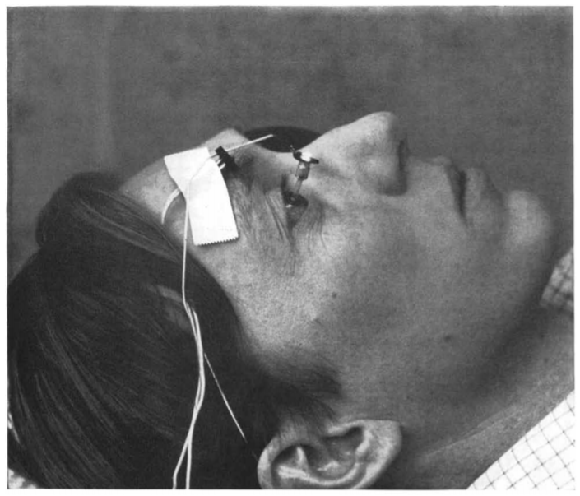
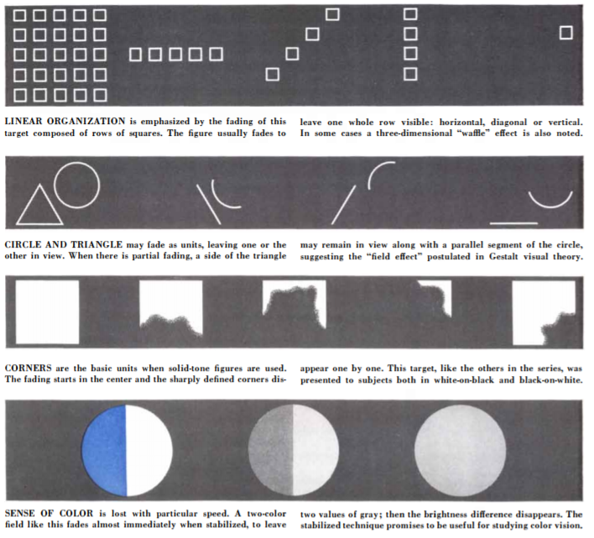
Eye movement
Experiments carried out in the 1950s:
Freeze the image by placing the projector on the contact lens
Effect: the image disappears (perceptually), no stimulation of eye photoreceptors
An example of a woman (the only one) with complete paralysis of the eye's muscles (fibrosis): she learn that nerves’ stimulation and thus vision is possible thanks to the head movement. She is even possible to read.
Gilchrist i in. Saccades without eye movements Nature 390 (1997) 130-131
Roy M. Pritchard Stabilized Images on the Retina (https://pdfs.semanticscholar.org/c97a/209e1a1caa088ae94987fe59317b5ef68838.pdf)

Slide 14
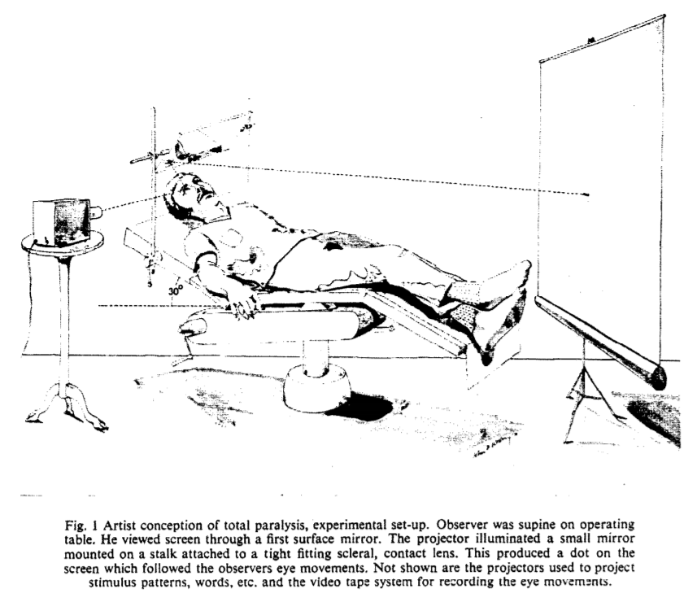
Eye movement
Experiment of Johna K. Stevensa:
JKS is object/observer.
Injection of a neuromuscular-blocking
drug (succinylcholine) and curare
A tourniquet on the right hand
prevents its paralysis (communication)
Breathing support (respirator)
Mirror and screen (stimulus)
The total immobilization of the eye
Image fading becomes a problem
Conscious attempts of sakad (effort)
caused the world to move? (despite
the lack of changes in the image!)
Conclusion: the perception of space is not
simple function of info. from senses,
but also of planned eye movements (sensory processing / integration)
John K. Stevens i in. Paralysis Of The Awake Human: Visual Perceptions Vision Research 16 (1976)
https://pdfs.semanticscholar.org/8567/8b73e4f918f05244b66ca2a9f65ef89ed3d9.pdf

Slide 15
Eye movement - Events
fixation
microsaccade
glisade
drift
saccade
fixation
The schema does not retain the
scale of the real eye movement

Slide 16
Eye movement - Events
Zdarzenie | Czas trwania | Długość | Prędkość
Fixation | 200-300 ms | - | -
Saccade | 30-80 ms | 4-20° | 300-500°/s
Glissade (correction after saccade) | 10-40 ms | 0.5-2° | 20-140°/s
Smooth pursuit | - | - | 10-30°/s
Drift (slow move of the gaze position out of the fixation center) | 200-1000 ms | 1-60’ | 6-25’/s
Microsaccade (correction after the drift) | 10-30 ms | 10-40’ | 15-50°/s
Tremor (of eye muscles) | - | < 1’ | < 20’/s

Slide 17
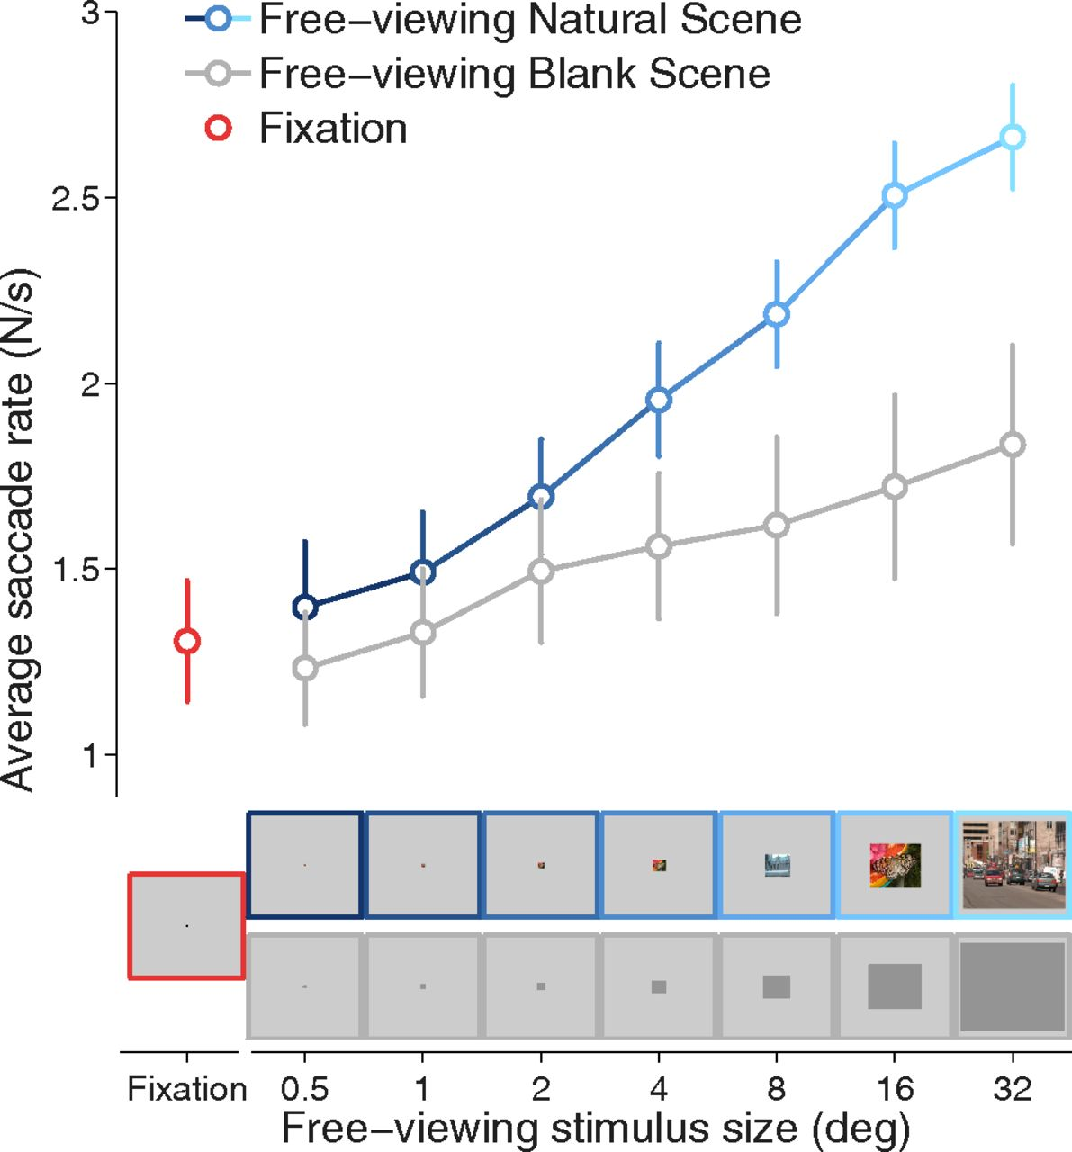
From exploration to fixation
Źródła: in. i Susanna Martinez-Conde From Exploration to Fixation: An Integrative View of Yarbus’s Vision
Perception 44 (2015) 884-899
Jorge Otero-Millan, Stephen L. Macknik, Rachel E. Langston and Susana Martinez-Conde
An oculomotor continuum from exploration to fixation PNAS 110 (2013) 6175-6180
As the size of the stimulus decreases
the parameters of saccades tends to
values typical for fixation (microsaccades)
Saccades and microsaccades
– the difference depends only on the stimulus
(maybe physiologically these are the same)

Slide 18
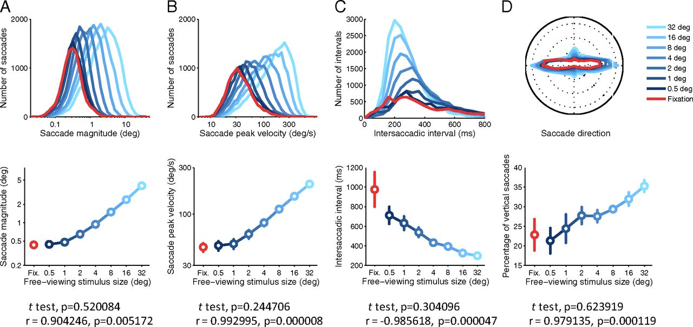
From exploration to fixation
Źródła: in. i Susanna Martinez-Conde From Exploration to Fixation: An Integrative View of Yarbus’s Vision
Perception 44 (2015) 884-899
Jorge Otero-Millan, Stephen L. Macknik, Rachel E. Langston and Susana Martinez-Conde
An oculomotor continuum from exploration to fixation PNAS 110 (2013) 6175-6180

Slide 19
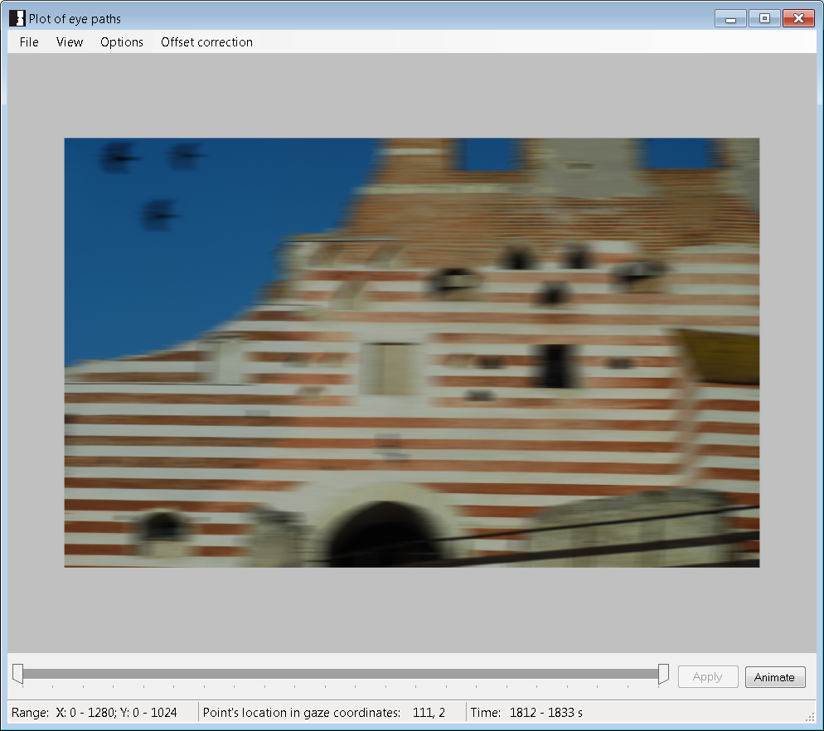
Stimulus

Slide 20
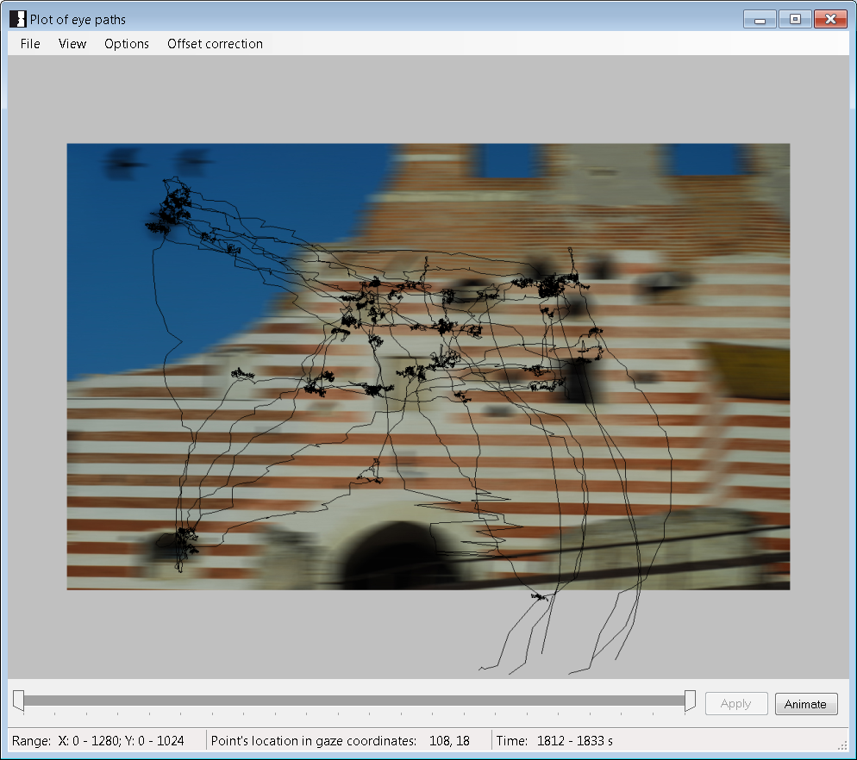
Gaze positions

Slide 21
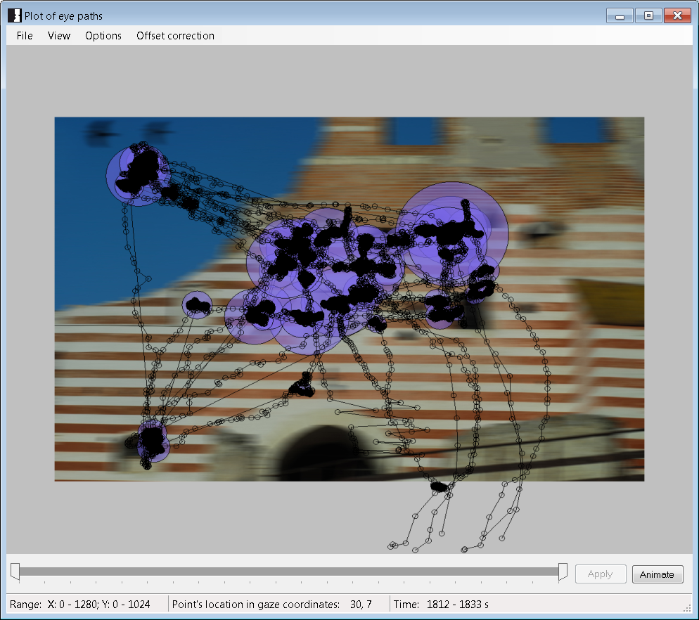
Fixations and saccades / gaze path

Slide 22
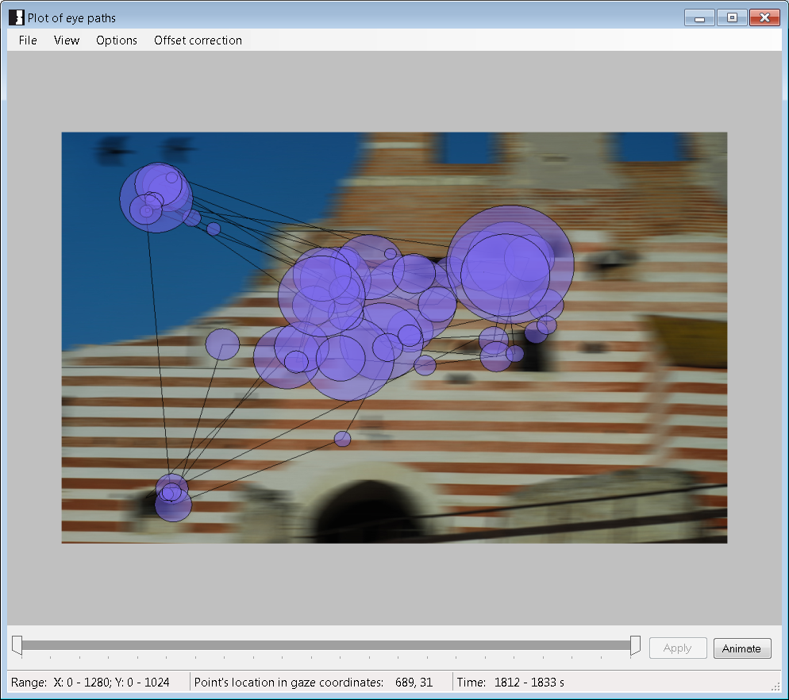
Fixations and saccades / gaze path

Slide 23
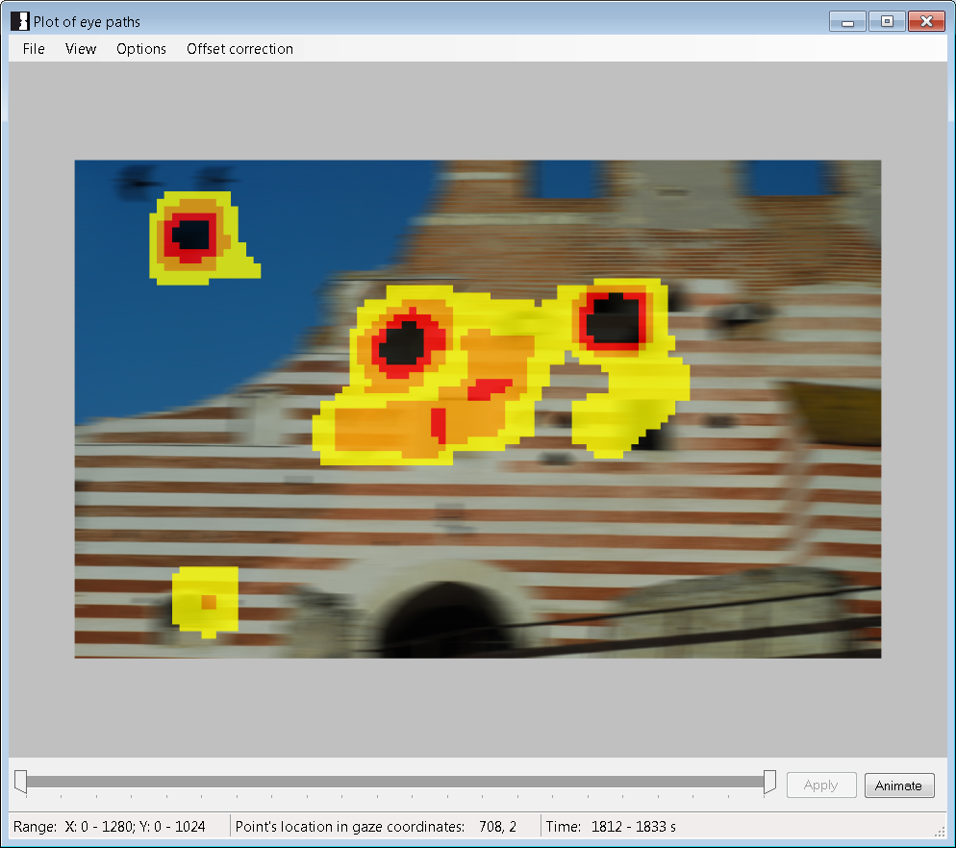
Heat map

Slide 24
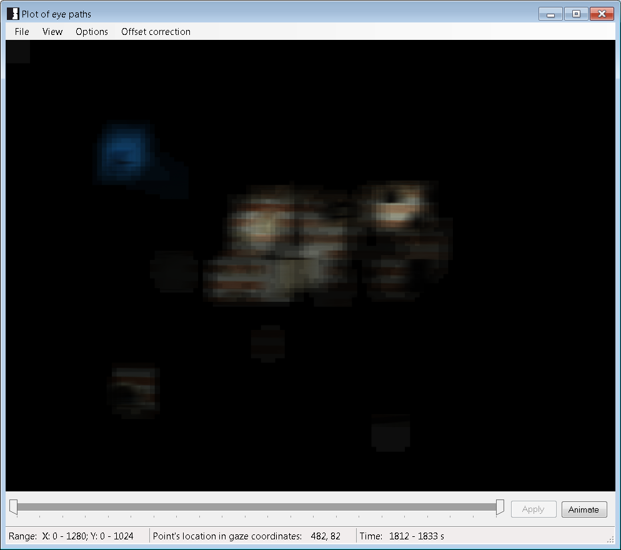
Attention map

Slide 25
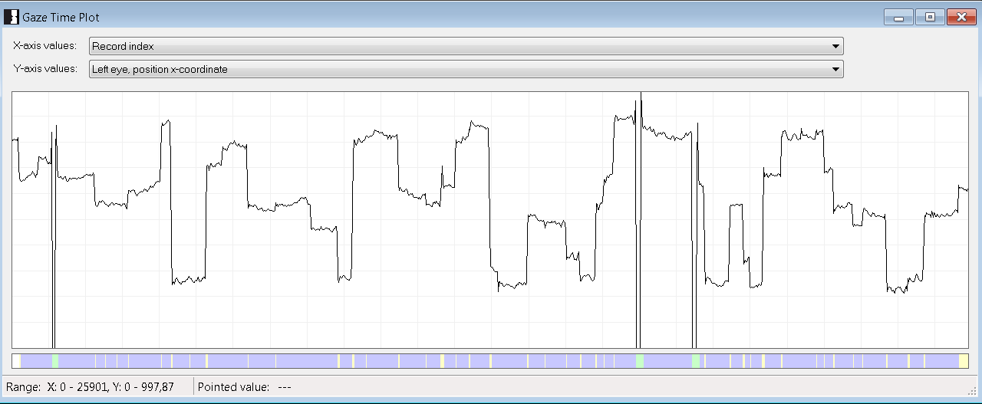
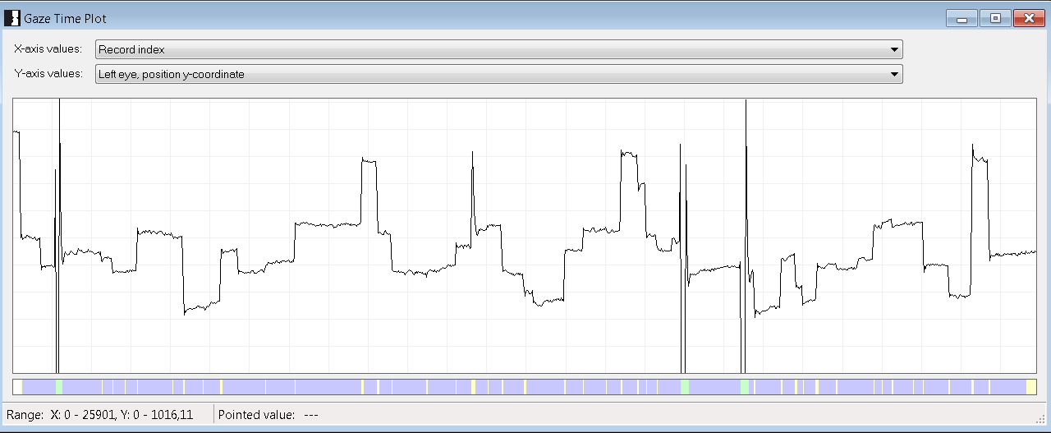
Gaze position x and y coordinates

Slide 26
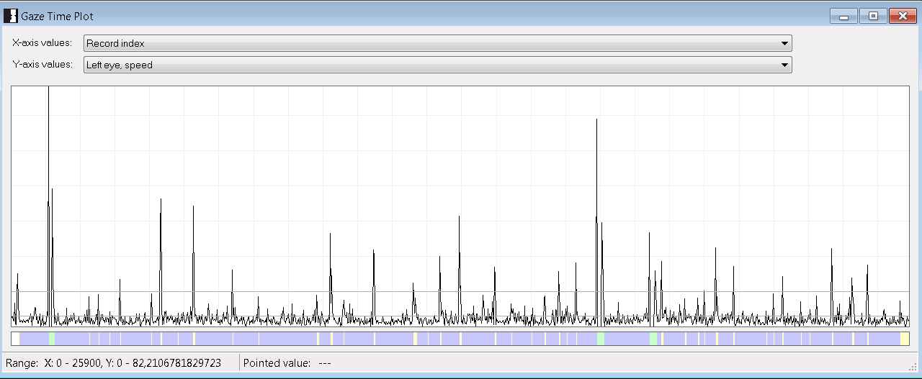
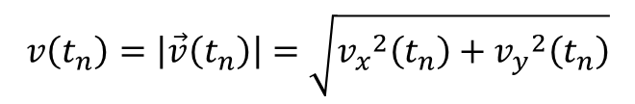
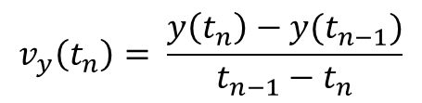
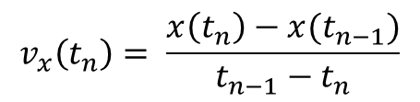
Speed of gaze
$$v_{x}\left(t_{n}\right)= \frac{x\left(t_{n}\right)−x(t_{n−1})}{t_{n−1}−t_{n}}$$
Euler’s algorithm (simplest)
$$v_{y}\left(t_{n}\right)= \frac{y\left(t_{n}\right)−y(t_{n−1})}{t_{n−1}−t_{n}}$$
$$v\left(t_{n}\right)=\left|\vec{v}\left(t_{n}\right)\right|=\sqrt{{v_{x}}_{}^{2}\left(t_{n}\right)+{v_{y}}_{}^{2}\left(t_{n}\right)}$$

Slide 27
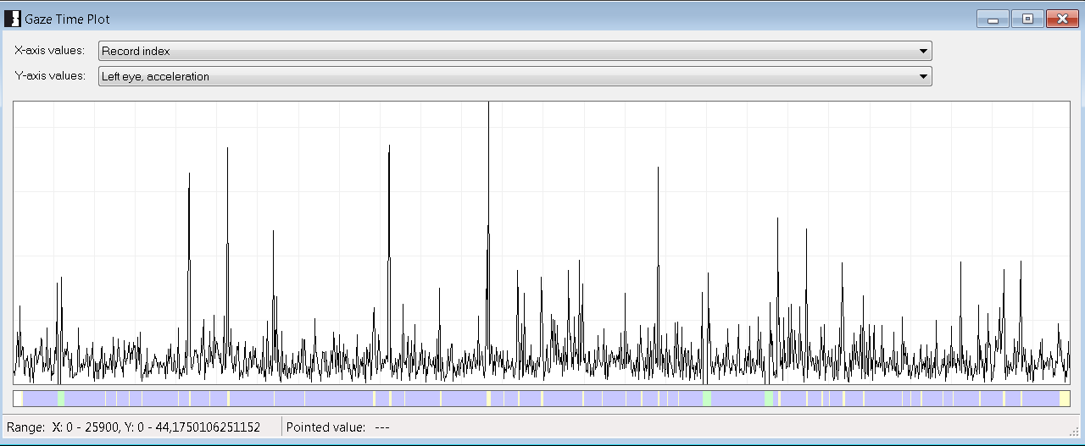
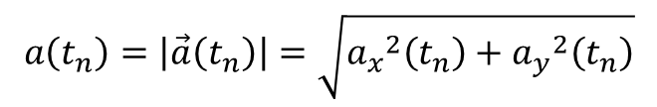
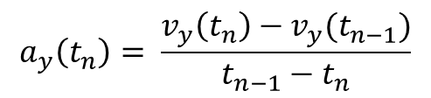
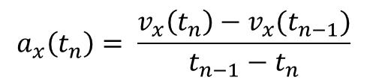
Gaze acceleration
$$a_{x}\left(t_{n}\right)= \frac{v_{x}\left(t_{n}\right)−v_{x}(t_{n−1})}{t_{n−1}−t_{n}}$$
Euler’s algorithm (simplest)
$$a_{y}\left(t_{n}\right)= \frac{v_{y}\left(t_{n}\right)−v_{y}(t_{n−1})}{t_{n−1}−t_{n}}$$
$$a\left(t_{n}\right)=\left|\vec{a}\left(t_{n}\right)\right|=\sqrt{{a_{x}}_{}^{2}\left(t_{n}\right)+{a_{y}}_{}^{2}\left(t_{n}\right)}$$

Slide 28
Events detection
Positional algorithm
Velocity algorithm
Fixation = group of samples for which
the position distribution is smaller
than the assumed threshold
Saccades = rest of samples
Fixation detection parameters:
- maximum dispersion in X / Y
- how to calculate the dispersion?
(variance, maximum distances)
- minimum duration of fixation
- minimum number of
samples during fixation
Saccade = a group of samples whose
speed is greater than the assumed
threshold
Fixations = rest of samples
Saccade detection:
- two- or three-point derivatives
- threshold speed or acceleration
- minimum speed at peak
- minimum duration
- minimum number of samples
- accuracy with which max speed is
located at the center of the peak

Slide 29
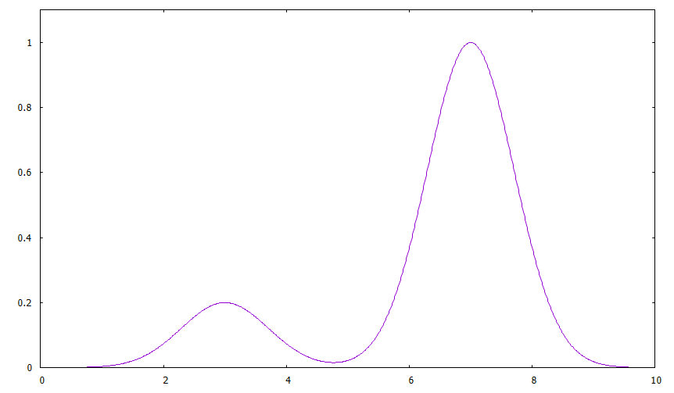
Velocity algorithm
Condition 3:
the minimum duration
(number of samples)
Additionally: saccade may be
extended to some speed
Aim: saccades detection
Rest of the time: fixations
Condition 1:
exceeding the
minimum
peak velocity
speed
Condition 2:
peak wings
fall below
threshold speed
time
Condition 4: peak at the center

Slide 30
Positional algorithm
Aim: fixations detection
Rest of the time: saccades
t_{f}
Condition 2:
minimum fixation duration
(or number of samples)
t_{i}
Condition 1:
dispersion of a samples group
does not exceed the maximum
values (separately in X and Y)
The method of dispersion calculating:
variance or maximum distance of samples

Slide 31
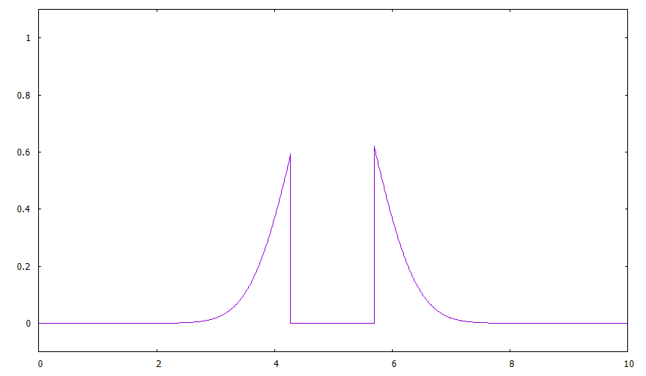
Events detection: blinking
Velocity algorithm
Blink = quasi-fixation in zero position
surrounded by two apparent saccades
Blink parameters:
- the minimum peak speed
of both saccades
- minimum duration of quasi-fixation
- tolerance for a zero fixation position

Slide 32
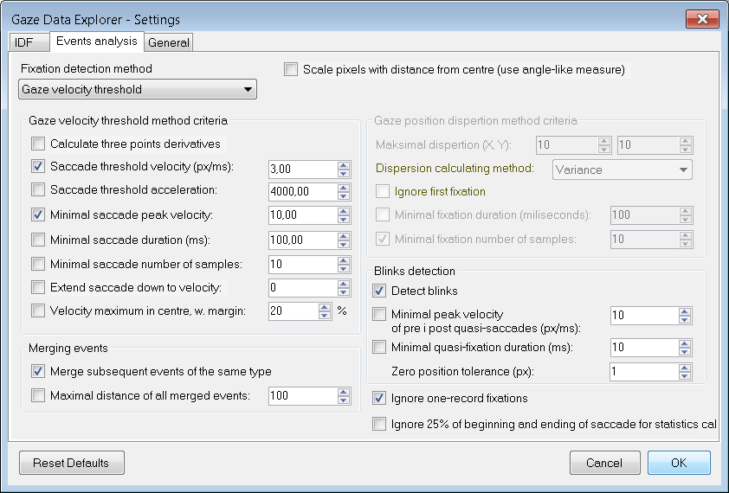
Events detection

Slide 33
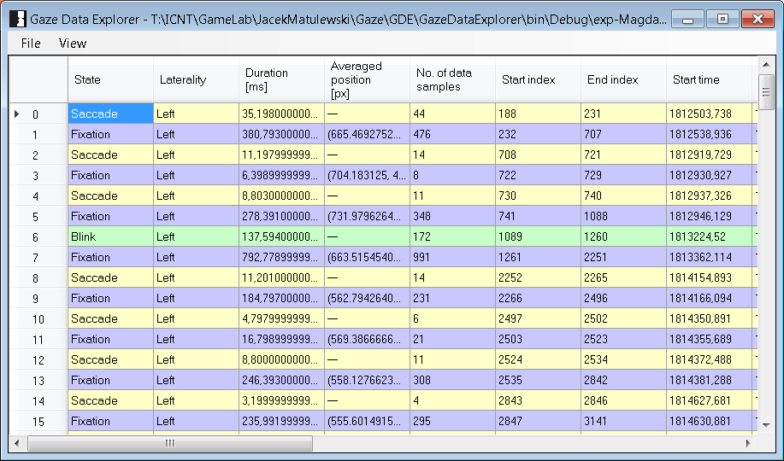
Events detection

Slide 34
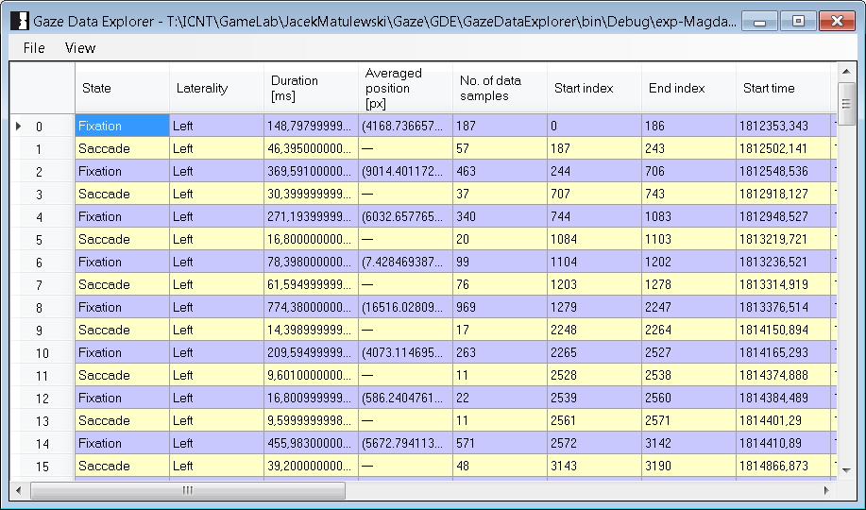
Events detection

Slide 35
Events detection: smooth pursuit
Smooth pursuit – „fixation on a moving object”
changing the gaze position in order to follow the object
usually impossible without the object (series of saccased)
speed lower than in case of saccades
If object is moving too fast (> 30°/s) smooth pursuit changes
into a sequence of catch-up saccades
Smooth pursuit is physiologically different from the vestibular-ocular reflex
(the eye movement compensating the head movement during fixation).
Some people can start smooth running just imagining the moving object
Smooth is easier for objects moving horizontally than vertically
(different brain areas are responsible)
Requires feedback with object
(but continues while the object is for a moment covered).
The first 100 ms - ballistic.

Slide 36
Areas of interests
1
4
2
3

Slide 37
Areas of interests
Area of interest (AOI)
An area of any shape (usually a rectangle or an ellipse) surrounding possible
object of interest (e.g. advertising, dashboard element in the car, product, etc.)
Measures:
Total time spent in the AOI
Total time spent in the AOI per area field (normalized)
Total time spent in the AOI per total time for whole stimulus
Number of gazes in the AOI and number of returns to the AOI
Number of fixations in the AOI,
percent of fixations in the AOI → interest in the detail/objects
Total duration of fixations in the AOI
Minimal, maximal and average duration of fixations in the AOI
Time to first fixation (TTFF) → visibility of the detail
Fixation dispersion

Slide 38
Areas of interests
Area of interest (AOI)
An area of any shape (usually a rectangle or an ellipse) surrounding possible
object of interest (e.g. advertising, dashboard element in the car, product, etc.)
Measures:
Number of saccades to the AOI, number of saccades from the the AOI
Speed of these saccades
Transition matrix among the AOIs
Number of blinks in the AOI, frequency of blinks in the AOI
Minimal, maximal and average duration of the blinks in the AOI

Slide 39
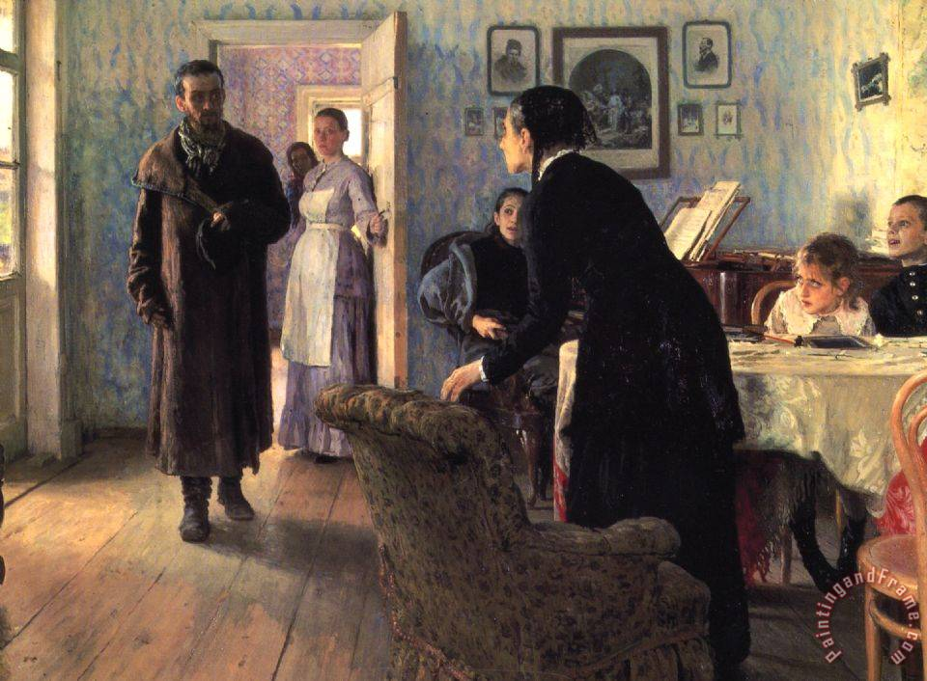
Gaze paths
Ilya Repin Unexpected visitor (1884-1888), oil on canvas, 160 x 167 cm
Wikipedia

Slide 40
Gaze paths
Lighting / color contrast
Ilya Repin Unexpected visitor (1884-1888), oil on canvas, 160 x 167 cm
Yarbus experiment (1967)
Wikipedia

Slide 41
Gaze paths
Gazes directions
Ilya Repin Unexpected visitor (1884-1888), oil on canvas, 160 x 167 cm
Yarbus experiment (1967)
Wikipedia

Slide 42
Gaze paths
Gaze directions / relations / emotions
Ilya Repin Unexpected visitor (1884-1888), oil on canvas, 160 x 167 cm
Yarbus experiment (1967)
Wikipedia

Slide 43
Gaze paths
Strong emotions, evolution
Ilya Repin Unexpected visitor (1884-1888), oil on canvas, 160 x 167 cm
Yarbus experiment (1967)
Wikipedia

Slide 44
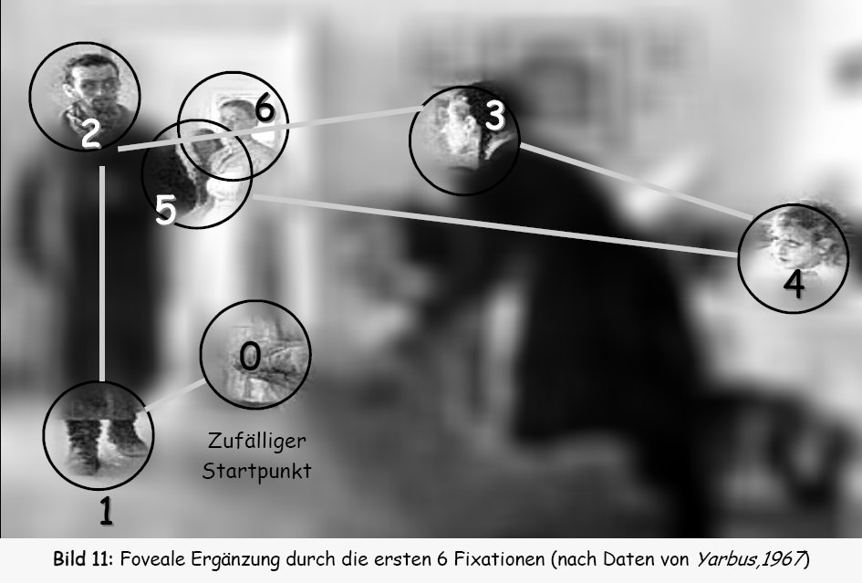
Gaze paths
Ilya Repin Unexpected visitor (1884-1888), oil on canvas, 160 x 167 cm
Yarbus experiment (1967)
Wikipedia

Slide 45
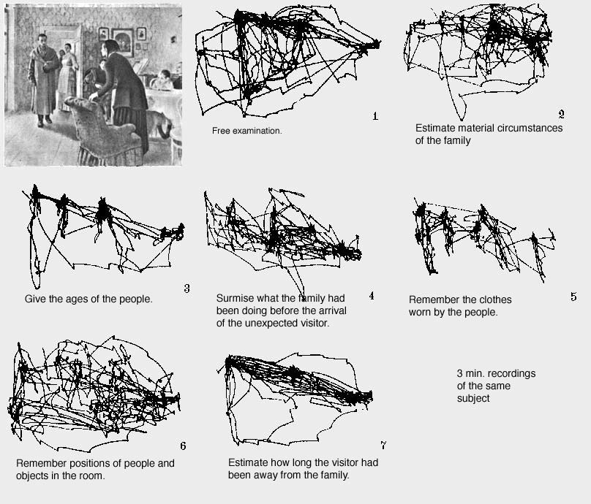
Gaze paths
Yarbus experiment (1967)
Wikipedia

Slide 46
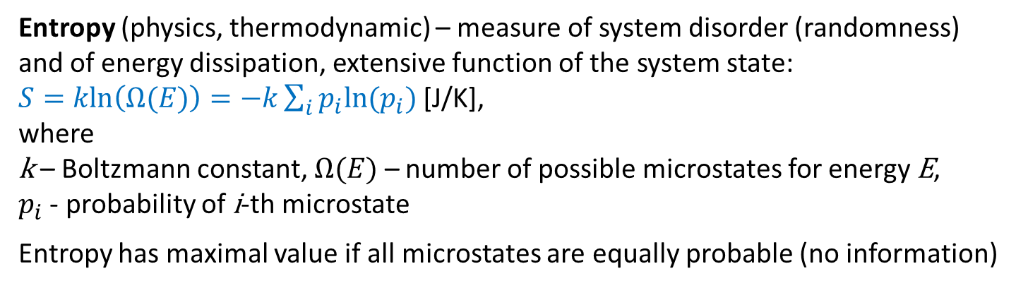
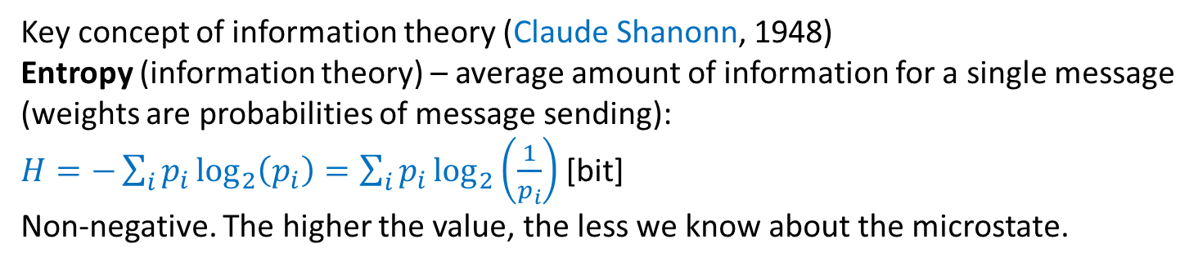
Entropy of information
Entropy (physics, thermodynamic) – measure of system disorder (randomness)
and of energy dissipation, extensive function of the system state:
$S=kln\left(Ω(E)\right)=−k\sum_{i}{p_{i}ln⁡(p_{i})}$ [J/K],
where
k – Boltzmann constant, $Ω(E)$ – number of possible microstates for energy E,
$p_{i}$ - probability of i-th microstate
Entropy has maximal value if all microstates are equally probable (no information)
Key concept of information theory (Claude Shanonn, 1948)
Entropy (information theory) – average amount of information for a single message
(weights are probabilities of message sending):
$H=−\sum_{i}{p_{i}\log_{2}\left(p_{i}\right)}=\sum_{i}{p_{i}\log_{2}\left(\frac{1}{p_{i}}\right)}$ [bit]
Non-negative. The higher the value, the less we know about the microstate.
C.E. Shannon A Mathematical Theory of Communication The Bell System Technical Journal 27 (1948) 379-423

Slide 47
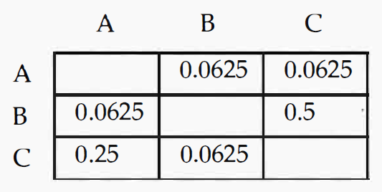
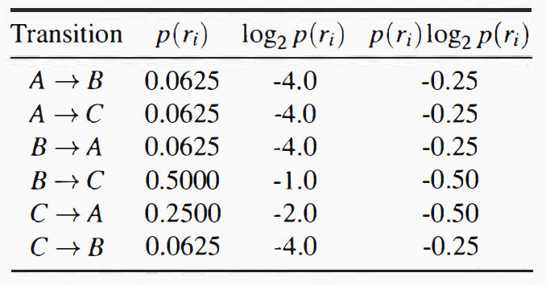

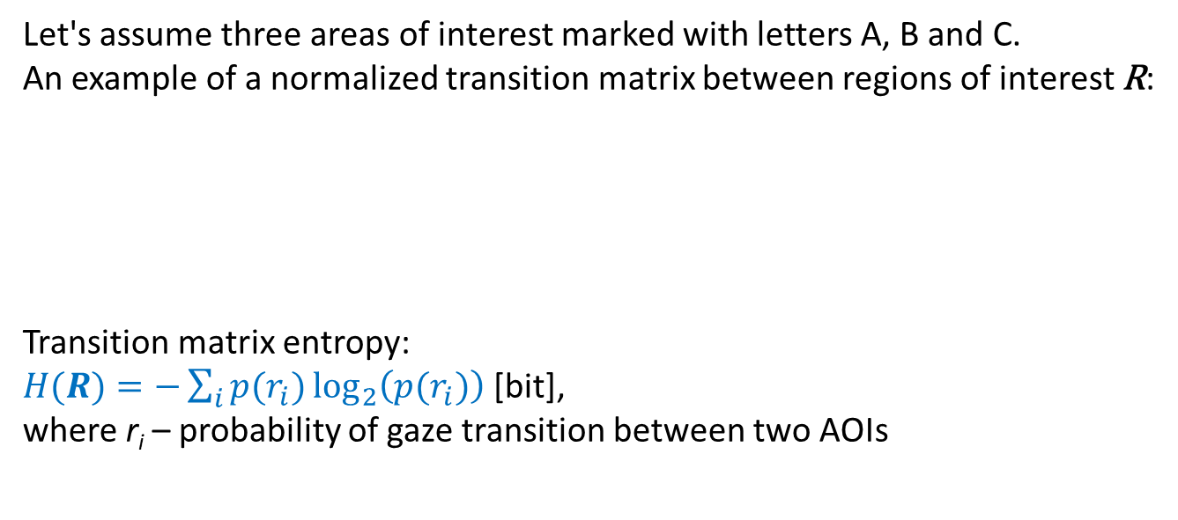
Transition matrix entropy
Let's assume three areas of interest marked with letters A, B and C.
An example of a normalized transition matrix between regions of interest R:
Transition matrix entropy:
$H(R)=−\sum_{i}{{p(r}_{i})\log_{2}\left({p(r}_{i})\right)}$ [bit],
where r_{i} – probability of gaze transition between two AOIs
Value equal to zero (complete knowledge)
- only in case of one AOI
Maximal value (no knowledge)
i.e. all probabilities are equal to 1/6.
H(R) = 2.59 bits
Normalized entropy (dimensionless) =
entropy divided by maximal value
H = 2/2.59 = 77.2%
Similar calculations can be made for time spend in AOIs, or even for a heat maps
(answer to another question)
$H = 2$ bits
Holmqvist i in. Eye Tracking: A Comprehensive Guide to Methods and Measures Oxford University Press 2011

Slide 48
Transition matrix entropy
Interpretation:
high values – exploration (transitions are equally probable),
low values – more accurate examination of selected stimulus details
(transitions occur only between selected areas, hence large differences in p(r_{i}))
The value of entropy is sensitive to the choice of AOIs
Experiment: during free exploration of the stimulus:
gradual decrease of the entropy value calculated for time intervals
(transition from exploration to examination of selected fragments/details)
Holmqvist i in. Eye Tracking: A Comprehensive Guide to Methods and Measures Oxford University Press 2011

Slide 49
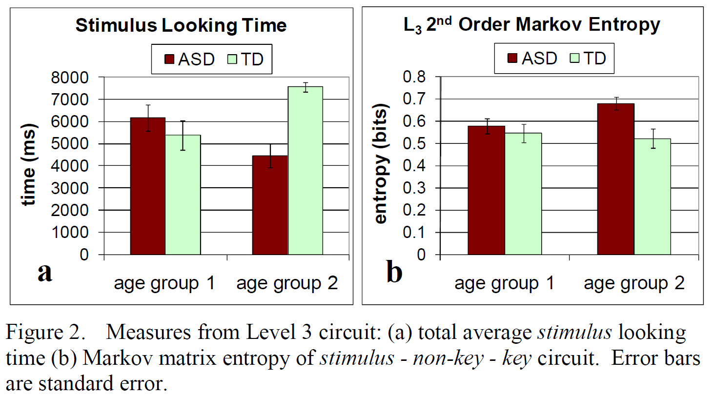

Transition matrix entropy
A well-known example of the use of entropy :
Shic, Chawarska, Scassellati (2008): different entropy values for healthy children
and children with ASD looking at the face image
avoidance…
2 i 4 y. old
Shic i in. Eye Tracking: Autism, Eye-Tracking, Entropy 7th IEEE International Conference on Development and Learning (2008)

Slide 50
Software stack for ET
feedback / ET as a controller
Game or experiment
Eye tracker device and software delivered by its manufacturer
Eye(s) images
Pupils position detection
25-2500 Hz
Simplified
event detection
Determining the gaze position
real-time
offline
Events analysis (fixations, saccades, blinks, ...)
Monitoring/Diagnosis/Experiments
Software from ET manufacturer, third party’s or user designed

Slide 51
Software stack for ET
feedback / ET as a controller
GIML / GCAF
Eye tracker device and software delivered by its manufacturer
Eye(s) images
Pupils position detection
GCAF
GIML
Determining the gaze position
real-time
IEyetracker
offline
Gaze Data Explorer (GDE)
Monitoring/Diagnosis/Experiments
Software from ET manufacturer, third party’s or user designed

Slide 52
Software stack for ET
feedback / ET as a controller
GIML / GCAF
Eye tracker device and software delivered by its manufacturer
Eye(s) images
Pupils position detection
GCAF
GIML
Determining the gaze position
real-time
IEyetracker
offline
Gaze Data Explorer (GDE)
Monitoring/Diagnosis/Experiments
Software from ET manufacturer, third party’s or user designed

