Slide 1
Attention deficits in autism and ADHD
Włodzisław Duch
Department of Informatics, Nicolaus Copernicus University, Toruń, Poland
School of Computer Engineering, Nanyang Technological University, Singapore
Google: Duch W
Innovative Methods of Neurorehabilitation, 4/2011

Slide 2
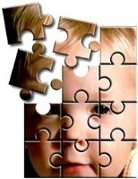
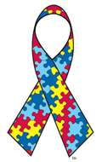
Plan:
How can we understand such disease as autism/ADHD? And who is in the best position to do it?
Theories, mistaking symptoms for causes.
What we hope to do?
Computational experiments.
Experimental evidence, genetics
Some ideas for neurorehabilitation & ICNT.
April is celebrated as the autism awareness month since 1970.

Slide 3
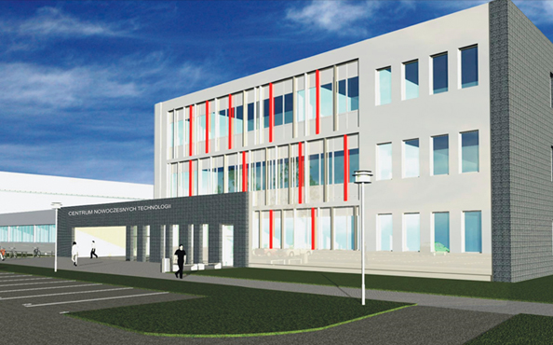
Interdisciplinary Center of Innovative Technologies
Why am I interested in this?
ICIT in construction, end of 2012?
Neurocognitive lab, 5 rooms, many
projects requiring experiments.
Working on FP7 grant.
Understanding brain plasticity, mind states.

Slide 4
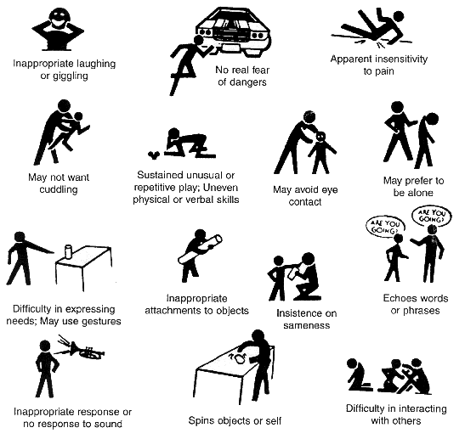
Autism Symptoms ...
Epidemics?
Prevalence ~1%.
Very diverse, perhaps not a single disease, but something like dementia.
Genetic components, but search for “autism genes” so far not too successful.

Slide 5
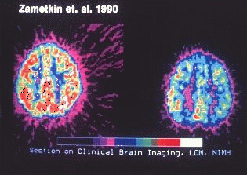
ADHD
Attention Deficit Hyperactivity Disorder, 3-5% of population (also adults).
Problems with attention: usually impulsive-hyperactive, inattentive (ADD)
Lack of impulse control, are easily distracted, miss details, forget things, frequently switch between activity, can’t focusing on one thing …
Motor restlessness, run non-stop, losing things, be very impatient, display strong emotions, act without thinking about consequences.
Bored quickly, have difficulty learning something new, completing homework.
Tendency to daydream.
ADHD involves functional disconnections between frontal and occipital cortex (A. Mazaheri, Biological Psychiatry, in print); psychologist talk about deficit in "top-down" attention control.
In many respects it is the opposite of ASD.

Slide 6
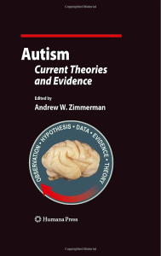
Theories, theories
Best book so far:
Zimmerman Andrew W. (Ed.) Autism; current theories and evidence. Humana Press 2008.
20 chapters divided into six sections:
Molecular and Clinical Genetics (4 chapters);
Neurotransmitters and Cell Signaling (3 chapters);
Endocrinology, Growth, and Metabolism (4 chapters);
Immunology, Maternal-Fetal Effects, and Neuroinflammation (4 chapters);
Neuroanatomy, Imaging, and Neural networks (3 chapters);
Environmental Mechanisms and Models (2 chapters).

Slide 7
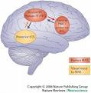
Mirror Neuron System
The mirror neuron system (MNS): multimodal (mostly motor) neurons, react to visual observations, observing action elicits similar motor activations as if it had been performed by oneself.
The MNS helps to understand actions of others, modeling their behavior via embodied simulation of their actions, intentions, and emotions.
MNS theory of autism (Williams et al, 2001): distortion in the development of the MNS interferes with the ability to imitate, leads to social impairment and communication difficulties.
Structural abnormalities in MNS regions of individuals with ASD exist, correlations between reduced MNS activity and severity of ASD.
But … in ASD abnormal brain activation in many other circuits; performance of autistic children on various imitation tasks may be normal.
MNS is not really a special system … the idea is used to explain almost everything in social neuroscience.

Slide 8
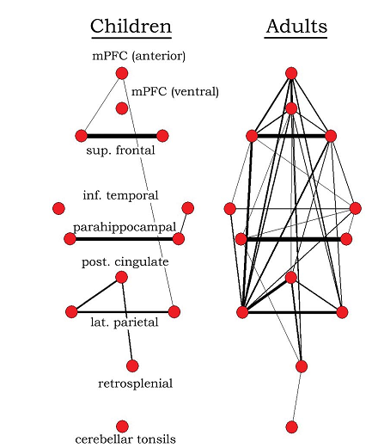
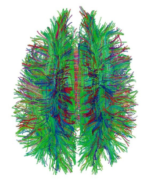
Reduced functional connectivity
The underconnectivity theory of autism is based on the following:
Excess of low-level (sensory) processes.
Underfunctioning of high-level neural connections and synchronization,
fMRI and EEG study suggests that adults with ASD have local overconnectivity in the cortex and weak functional connections between the frontal lobe and the rest of the cortex.
Underconnectivity is mainly within each hemisphere of the cortex and that autism is a disorder of the association cortex.
Patterns of low function and aberrant activation in the brain differ depending on whether the brain is doing social or nonsocial tasks.
“Default brain network” involves a large-scale brain network (cingulate cortex, mPFC, lateral PC), shows low activity for goal-related actions; it is active in social and emotional processing, mindwandering, daydreaming.
Activity of the default network is negatively correlated with the “action network” (conscious goal-directed thinking), but this is not the case in autism – perhaps disturbance of self-referential thought?

Slide 9
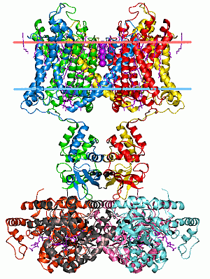
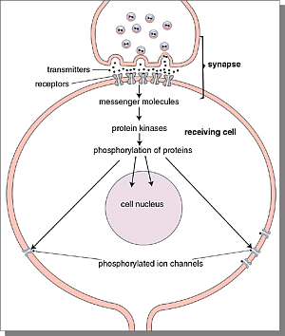
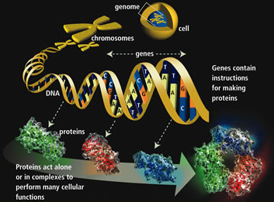
From Genes to Neurons
Genes => Proteins => ion channels, synapses => neuron properties, networks
=> neurodynamics => abnormal behavior!

Slide 10
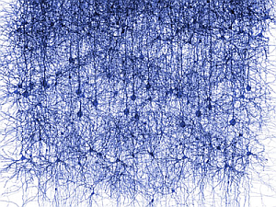
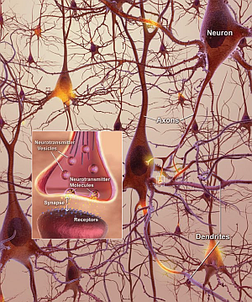
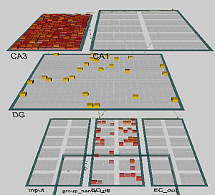
From Neurons to Behavior
Genes => Proteins => ion channels, synapses => neuron properties, networks
=> neurodynamics => abnormal behavior!

Slide 11
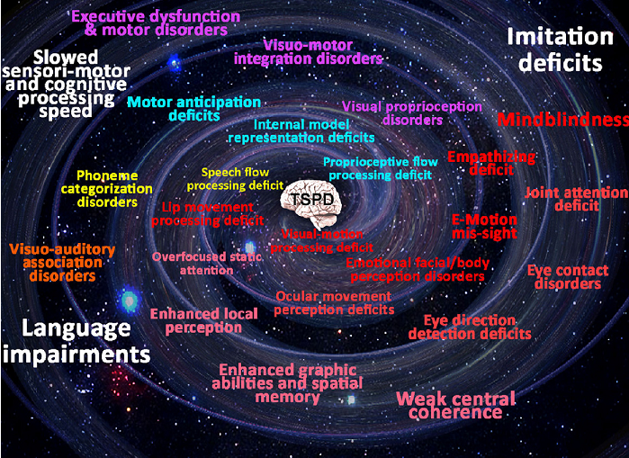
Temporo-spatial processing disorders
B. Gepner, F. Feron, Autism: A world changing too fast for a mis-wired brain? Neurosci. Biobehav. Rev. (2009).

Slide 12
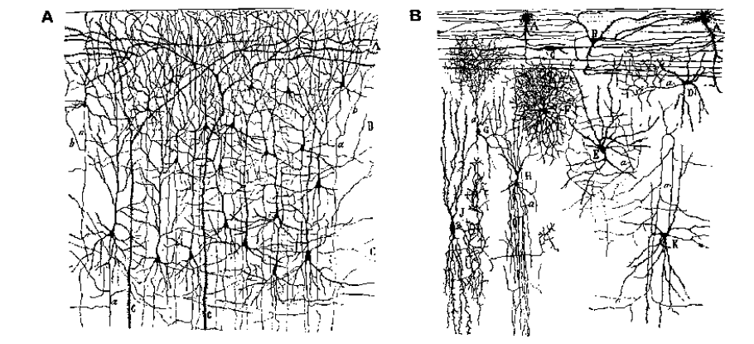
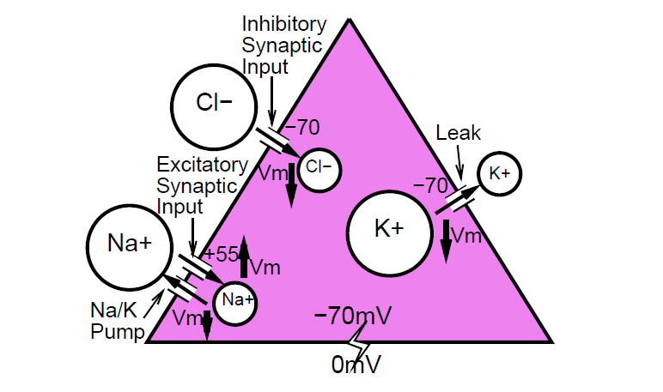
Excitatory and inhibitory neurons
Glutamic acid/ACh opens Na⁺ excitatory channels. GABA inhibits neural activity working on Cl⁻ channels.

Slide 13
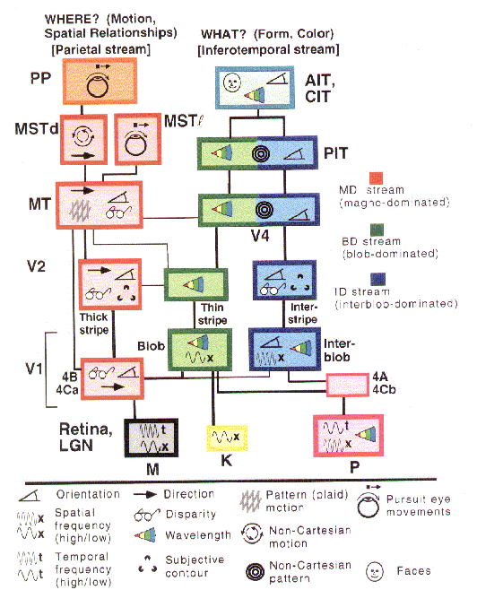
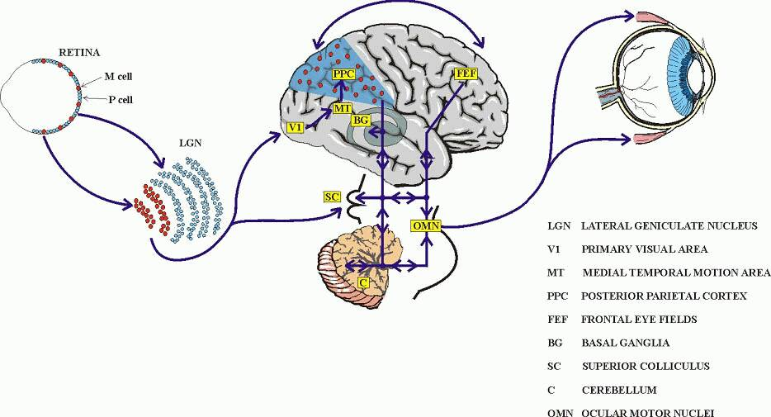
Vision
From retina through lateral geniculate body, LGN (part of thalamus) information passes to the primary visual cortex V1 and then splits into the ventral and dorsal streams.

Slide 14
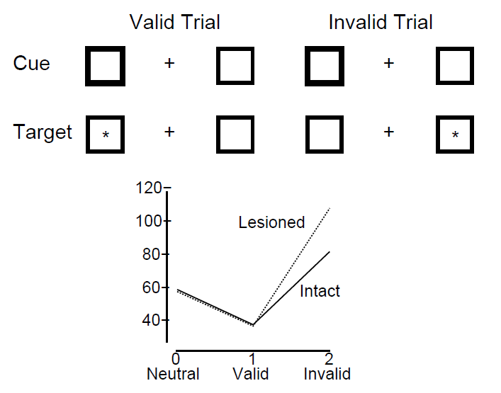
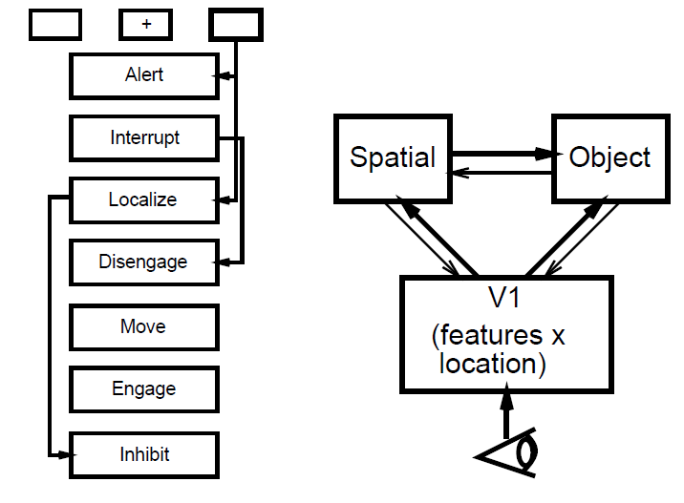
Simple model of Posner experiments
Cue (bright box) is in the same position as target (valid trial), or in another position (invalid trial), or there is no cue (neutral).

Slide 15
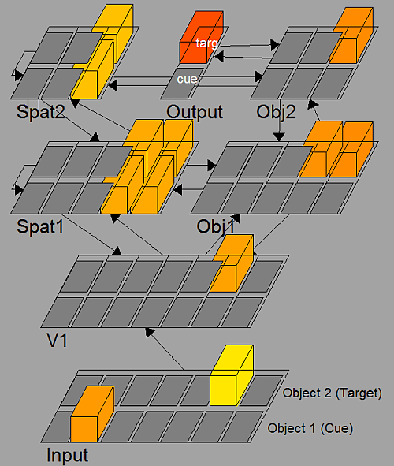
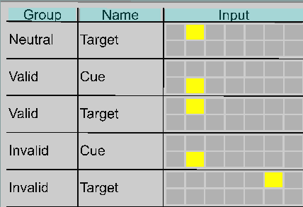
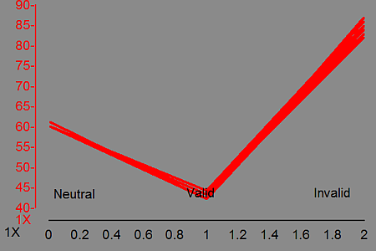
Posner spatial attention
Cue (bright box) is in the same position as target (valid trial), or in another position (invalid trial), or there is no cue (neutral).

Slide 16
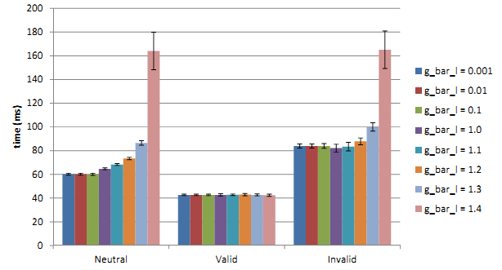
Posner spatial attention
Spatial attention shifts in Posner experiments as a function of leak channel conductance.
Cue pulsating with different frequencies: resonances?
Compensation effects: what changes in the network will lead to faster attention shifts?
Broadening of attractor basins
Diagnostics?
Fever?
Pharmacotherapy?

Slide 17
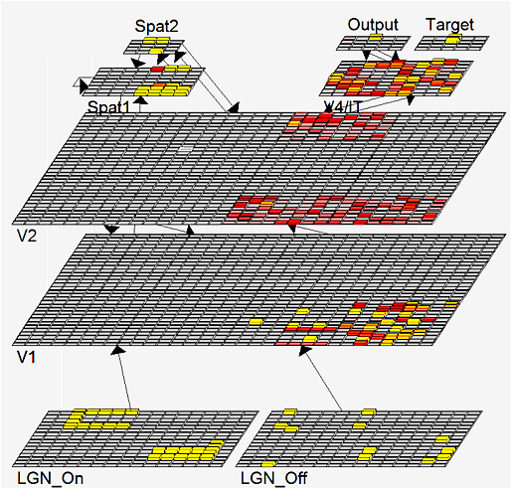
Recognition of many objects
Vision model including LGN, V1, V2, V4/IT, V5/MT
Two objects are presented.
Connectivity of these layers: Spat1 ⬄ V2, Spat 2 Spat1 ⬄ V2, Spat 2 Spat2 ⬄ V2.
Spat1 has recurrent activations and inhibition, focusing on a single object.
In normal situations neurons desynchronize and synchronize on the second object = attention shift.

Slide 18
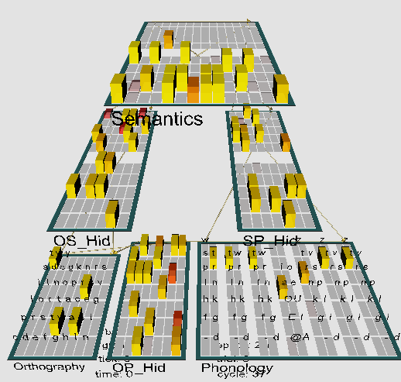
Model of reading
Emergent neural simulator:
Aisa, B., Mingus, B., and O'Reilly, R. The emergent neural modeling system. Neural Networks, 21, 1045-1212, 2008.
3-layer model of reading:
orthography, phonology, semantics, or distribution of activity over 140 microfeatures of concepts.
Hidden layers in between.
Learning: mapping one of the 3 layers to the other two.
Fluctuations around final configuration = attractors representing concepts.
How to see properties of their basins, their relations?

Slide 19
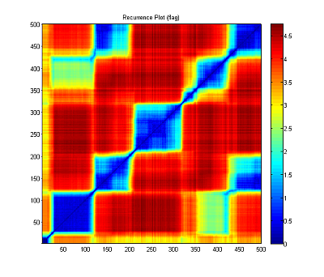
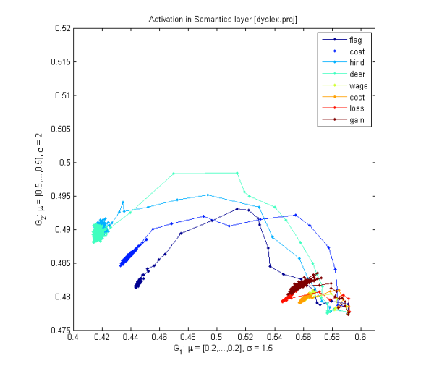
Fuzzy Symbolic Dynamics (FSD)
Trajectory of dynamical system (neural activities), using recurrent plots (RP):
RP plots S(t,t₀) values as a matrix; FSD
1. Standardize data.
2. Find cluster centers (e.g. by k-means algorithm): μ₁, μ₂ ...
3. Use non-linear mapping to reduce dimensionality:
Localized membership functions y_{k}(t;W):
sharp indicator functions => symbolic dynamics; x(t) => strings of symbols;
soft membership functions => fuzzy symbolic dynamics, dimensionality reduction Y(t)=(y₁(t;W), y₂(t;W)) => visualization of high-dim data.
Dobosz K, Duch W. (2010) Understanding Neurodynamical Systems via Fuzzy Symbolic Dynamics. Neural Networks Vol. 23 (2010) 487-496

Slide 20
Neurodynamics
Attention results from:
inhibitory competition,
bidirectional interactive processing,
multiple constraint satisfaction.
Basins of attractors: input activations {LGN(X)}=> object recognition
Normal case: relatively large, easy associations, moving from one basin of attraction to another, exploring the activation space.
Without accommodation (voltage-dependent K⁺ channels): deep, narrow basins, hard to move out of the basin, associations are weak.
Accommodation: basins of attractors shrink and vanish because neurons desynchronize due to the fatigue. This allows other neurons to synchronize, guided by Spat => V2 => V1 feedback.

Slide 21
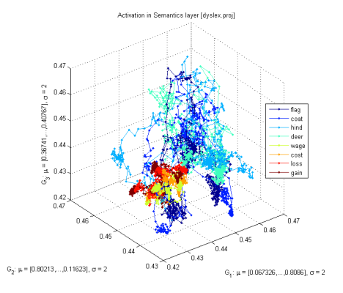
Attractors for words
Model for reading includes phonological, orthographic and semantic layers with hidden layers in between.
Non-linear visualization of activity of the semantic layer with 140 units.
Cost and rent have semantic associations, attractors are close to each other, but without accommodation transitions between basins of attractions are hard.
Will it manifest in verbal priming tests? Free associations?
Will broadening of phonological/written form representations help?
For example, training ASD children with characters that vary in many ways (shapes, colors, size, rotations).

Slide 22
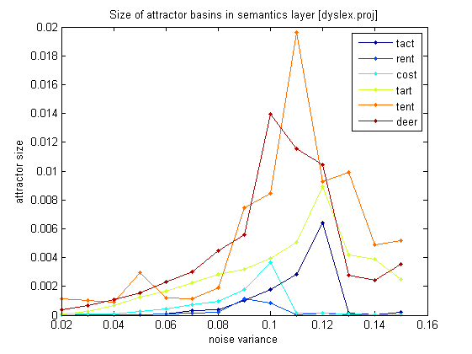
Depth of attractor basins
Variance around the center of a cluster grows with synaptic noise; for narrow and deep attractors it will grow slowly, but for wide basins it will grow fast.
Jumping out of the attractor basin reduces the variance due to inhibition of desynchronized neurons.

Slide 23
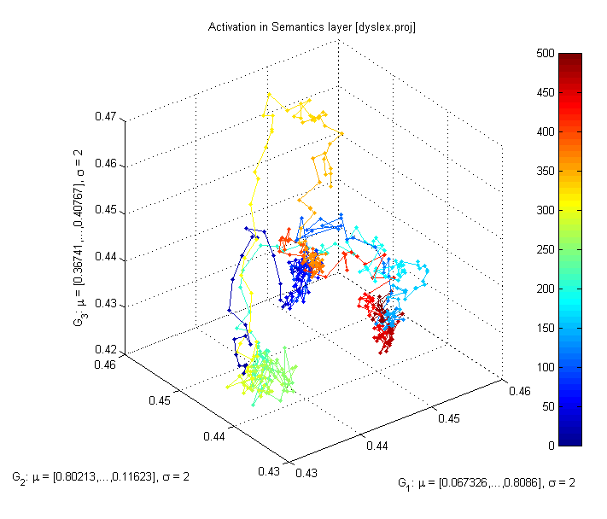
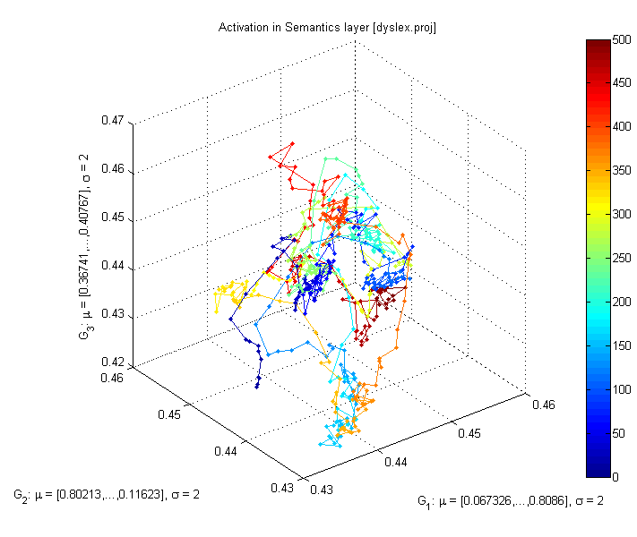
Normal-ADHD
All plots for the flag word, different values of b_inc_dt parameter in the accommodation mechanism. b_inc_dt = 0.01 & b_inc_dt = 0.02
b_inc_dt = time constant for increases in intracellular calcium which builds up slowly as a function of activation.
http://kdobosz.wikidot.com/dyslexia-accommodation-parameters

Slide 24
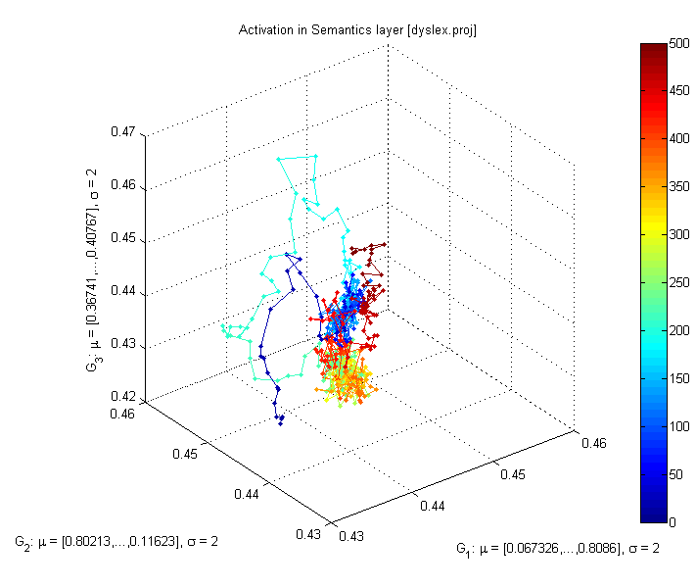
Normal-Autism
All plots for the flag word, different values of b_inc_dt parameter in the accommodation mechanism. b_inc_dt = 0.01 & b_inc_dt = 0.005
b_inc_dt = time constant for increases in intracellular calcium which builds up slowly as a function of activation.
http://kdobosz.wikidot.com/dyslexia-accommodation-parameters

Slide 25
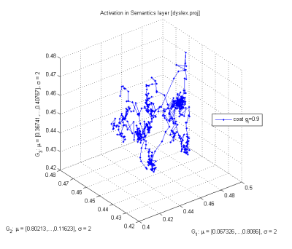
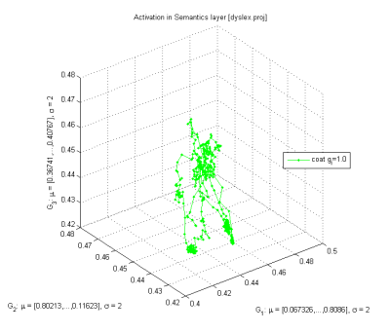
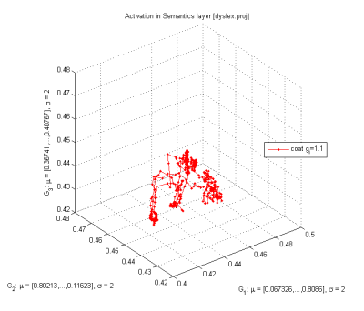
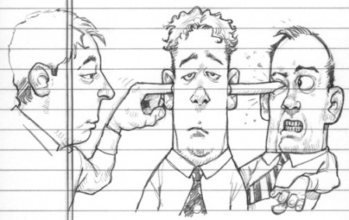
Inhibition
Increasing g_{i} from 0.9 to 1.1 reduces the attractor basin sizes and simplifies trajectories.
Strong inhibition,
empty head …

Slide 26
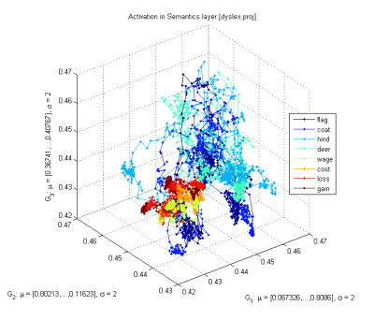
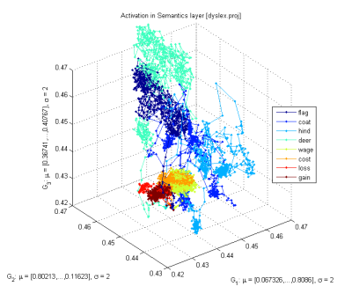
Connectivity
With small synaptic noise (var=0.02) the network starts from reaching an attractor and moves to another one (frequently quite distant), creating a “chain of thoughts”.
Same situation, with stronger recurrent connections within layers; fewer but larger attractor basins are created, and more time is spent in each basin.

Slide 27
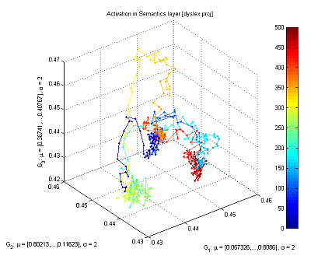
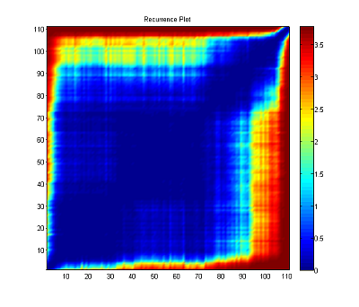
Recurrence plots
Starting from the word “flag”, with small synaptic noise (var=0.02), the network starts from reaching an attractor and moves to another one (frequently quite distant), creating a “chain of thoughts”.
Same trajectories displayed with recurrence plots, showing roughly 5 larger basins of attractors and some transient points.

Slide 28
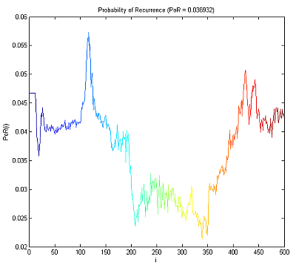
Probability of recurrence
Probability of recurrence may be computed from recurrence plots, allowing for evaluation how strongly some basins of attractors capture neurodynamics.

Slide 29
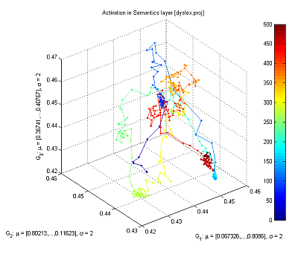
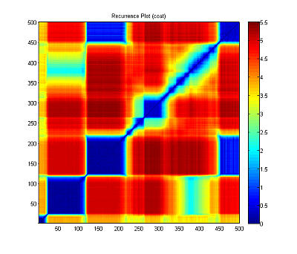
Fast transitions
Attention is focused only for a brief time and than moved to the next attractor basin, some basins are visited for such a short time that no action may follow, corresponding to the feeling of confusion and not being conscious of fleeting thoughts.

Slide 30
Some speculations
Attention shifts may be impaired due to several factors:
Deep and narrow attractors that entrap dynamics – leak channels?
Explains overspecific memory in ASD, unusual attention to details, the inability to generalize visual and other stimuli, also fever effect?
Accommodation: voltage-dependent K⁺ channels (~40 types) do not decrease depolarization in a normal way, attractors do not shrink.
This effect should also slow down attention shifts and reduce jumps to unrelated thoughts or topics relatively to average person – neural fatigue will temporarily switch them off preventing activation of attractors that code significantly overlapping concepts.
What behavioral changes are expected? How to tests for them?

Slide 31
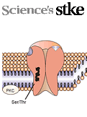
Research/diagnostic consequences
Many problems at genetic/molecular level may lead to the same behavioral symptoms => problems for statistically-oriented research methods.
Genetic mutation should give weak signals: in a given population of autistic patients only small fraction will have a given mutation.
Inconclusive results on diet: several studies show some improvement, other studies show no effect.
Pharmacological and other treatments will have limited success.
Need for a better diagnostics at molecular/genetic level!
Strategy: behavior <= neural properties;
find neural parameters that affect behavior in a specific way;
try to relate them to molecular properties in synapses, various receptors, ion channels (pore forming proteins), membrane properties;
try to find markers for specific abnormalities.

Slide 32
Behavioral consequences
Deep, localized attractors are formed; what are the consequences?
Problems with disengagement of attention;
hyperspecific memory for images, words, numbers, facts, movements;
strong focus on single stimulus, absorption, easy sensory overstimulation;
gaze focused on simple stimuli, not faces, contact is difficult;
echolalia, repeating words without understanding (no associations);
nouns are acquired more readily than abstract words like verbs;
play is schematic, fast changes are not noticed (stable states cannot arise);
play with other children is avoided in favor of simple toys;
generalization and associations are quite poor; integration of different modalities that requires synchronization is impaired, connections are weak;
normal development – theory of mind, MNS, relations – is impaired.
Simple basic deficit => host of problems, many insights from simple mechanism.
Expect great diversity, depending on local expression and severity.

Slide 33
Experimental evidence: behavior
Kawakubo Y, et al. Electrophysiological abnormalities of spatial attention in adults with autism during the gap overlap task. Clinical Neurophysiology 118(7), 1464-1471, 2007.
“These results demonstrate electrophysiological abnormalities of disengagement during visuospatial attention in adults with autism which cannot be attributed to their IQs.”
“We suggest that adults with autism have deficits in attentional disengagement and the physiological substrates underlying deficits in autism and mental retardation are different.”
Landry R, Bryson SE, Impaired disengagement of attention in young children with autism. Journal of Child Psychology and Psychiatry 45(6), 1115 - 1122, 2004
“Children with autism had marked difficulty in disengaging attention. Indeed, on 20% of trials they remained fixated on the first of two competing stimuli for the entire 8-second trial duration.”
Several newer studies: Mayada Elsabbagh.

Slide 34
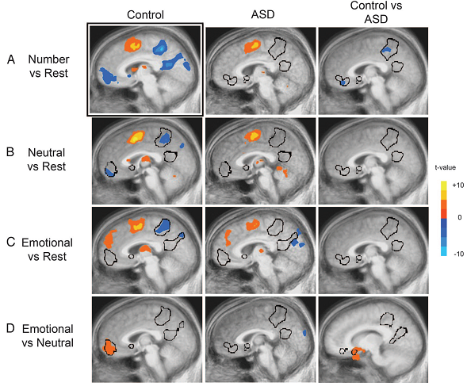
Experimental evidence: behavior
D.P. Kennedy, E. Redcay, and E. Courchesne,
Failing to deactivate: Resting functional abnor- malities in autism. PNAS 103, 8275-8280, 2006.
Default network in autism group failed to deactivate brain regions, strong correlation between a clinical measure of social impairment and functio- nal activity within the ventral MPF.
Mistaking symptoms for real problems: We speculate that the lack of deactivation in the autism group is indicative of abnormal internally directed processes at rest.

Slide 35
Mistaking symptoms for causes
Various brain subsystems develop in an abnormal way:
1. Abnormal functional connectivity between extra striate and temporal cortices during attribution of mental states, and executive tasks such as memory for or attention to social information (Castelli et al., 2002 ; Just et al., 2004, 2007; Kana et al., 2007a, b; Dichter et al., 2007; Kleinhans et al., 2008).
2. Underconnectivity: working memory, face processing (Just et al., 2007; Koshino et al., 2008; Bird et al., 2006), cortico-cortical connectivity (Barnea-Goraly et al., 2004; Herbert et al., 2004; Keller et al., 2007).
3. Default mode network: “Results revealed that while typically developing individuals showed enhanced recall skills for negative relative to positive and neutral pictures, individuals with ASD recalled the neutral pictures as well as the emotional ones. Findings of this study thus point to reduced influence of emotion on memory processes in ASD than in typically developing individuals, possibly owing to amygdala dysfunctions.”
C. Deruelle et al., Negative emotion does not enhance recall skills in adults with autistic spectrum disorders. Autism Research 1(2), 91–96, 2008

Slide 36
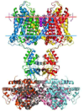
Experimental evidence: molecular
What type of problems with neurons create these types of effects?
Neural self-regulation mechanisms lead to fatigue or accommodation of neurons through leaky K⁺ channels opened by high Ca⁺⁺ concentration, or longer acting GABA-B inhibitory synaptic channel.
This leads to inhibition of neurons that require stronger activation to fire.
Neurons accommodate or fatigue and become less and less active for the same amount of excitatory input.
Dysregulated calcium signaling, mainly through voltage-gated calcium channels (VGCC) is the central molecular event that leads to pathologies of autism.
http://www.autismcalciumchannelopathy.com/
Calcium homeostasis in critical stages of development may be perturbed by genetic polymorphism related to immune function and inflammatory reactions and environmental influences (perinatal hypoxia, infectious agents, toxins).
Genetic mutations => proteins building incorrect potassium channels (CASPR2 gene) and sodium channels (SCN2A gene).

Slide 37
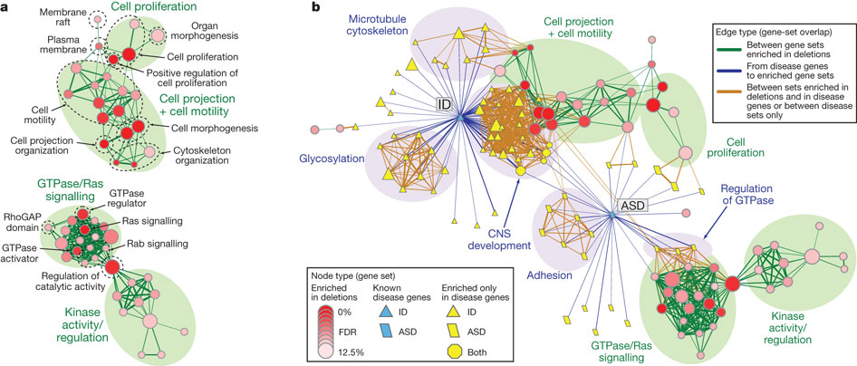
Genes & functions
http://www.sciencebasedmedicine.org/?p=5662
Pinto, D. + 180 coauthors ... (2010). Functional impact of global rare copy number variation in autism spectrum disorders Nature DOI: 10.1038/nature09146

Slide 38
Questions/Ideas
Neurodynamics: good language to speak about mental processes.
There are many parameters characterizing biophysical properties of neurons and their connections within different layers.
How does depth/size of basins of attractors depend on these parameters?
How to measure and/or visualize attractors? Real effects or artefacts?
How do attractors depend on the dynamics of neuron accommodation? Noise? Inhibition strength, local excitations, long-distance synchronization?
How will symptoms differ depending on specific brain areas? For example, mu suppression may be due to deep attractors …
What are precise relations to ion channels and proteins that build them?
How can they be changed by pharmacological interventions?

Slide 39
More questions/ideas
How learning procedures may influence formation of basins of attractors? For example, learning to read may depend on the variability of fonts, handwriting may be much more difficult etc.
Slow broadening of attractor basins?
Spontaneous thoughts, local energy with low neural accommodation?
Can one draw useful suggestions how to compensate for such deficits?
Spatial attention shifts in Posner experiments - resonances?
Precise diagnostics, what type of problems at genetic/molecular level?
Compensation effects: what changes in the network will lead to faster attention shifts?
Will it help in diagnostics/therapy? We need to finish computational simulations and then to test some ideas.

Slide 40
Brains & Music 22-24.05.2011! http://www.kognitywistyka.umk.pl/2011/

